Slide 1
6 – IBFE – What do Boyce’s examples do?

Slide 2
IBFE examples
Please see Griffith and Luo, 2017 (google drive folder)
Hybrid finite difference/finite element immersed boundary method

Slide 3
Tips for running examples
Remember to move a Makefile and script.sh to each folder.
Make sure the Makefile has the right dimensions, make sure the script.sh uses the right input file.
Some of the examples go unstable (timestep size change encountered). Just reduce DT in the input file and rerun.
Some of the examples have other .C or .cpp files for convergence tests, etc.. The Makefile we use compiles all .C files in the folder. Drop the .C / .cpp and then make.

Slide 4
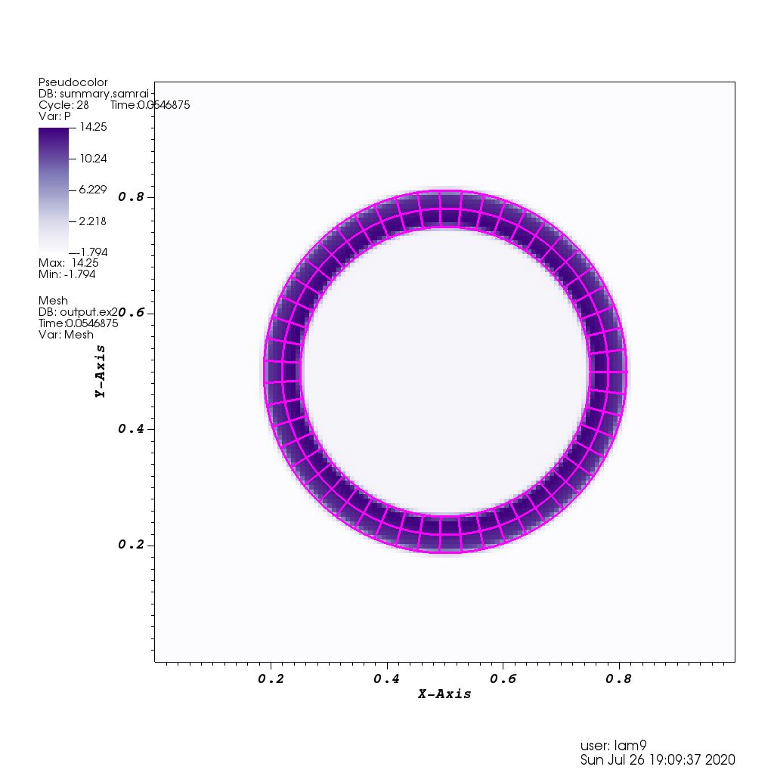
IBFE ex0
This is a pressurized shell, the colormap shows the pressure.
There is no significant fluid motion.
I believe that this tests the conservation of volume in the shell. The volume.curve output file shows volume over time.

Slide 5
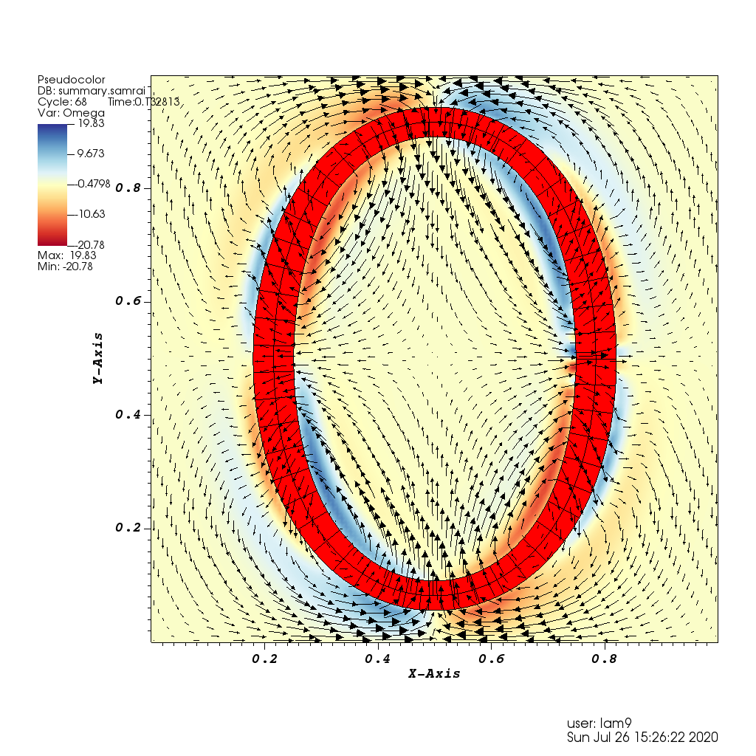
IBFE ex1
This is a shell that is initialized as an ellipse.
The colormap shows vorticity, and the arrows show the velocity.
There are convergence_tester files you want to remove or rename to run with our Makefile.

Slide 6
IBFE ex1, continued
This example comes from Figure 4, Griffith and Luo
“Representative results from the dynamic (𝛾 = 0.15) version of the idealized anisotropic shell model of Section 5.1.1 for N = 128 over the time interval 0 ⩽ t ⩽ 0.75.”

Slide 7
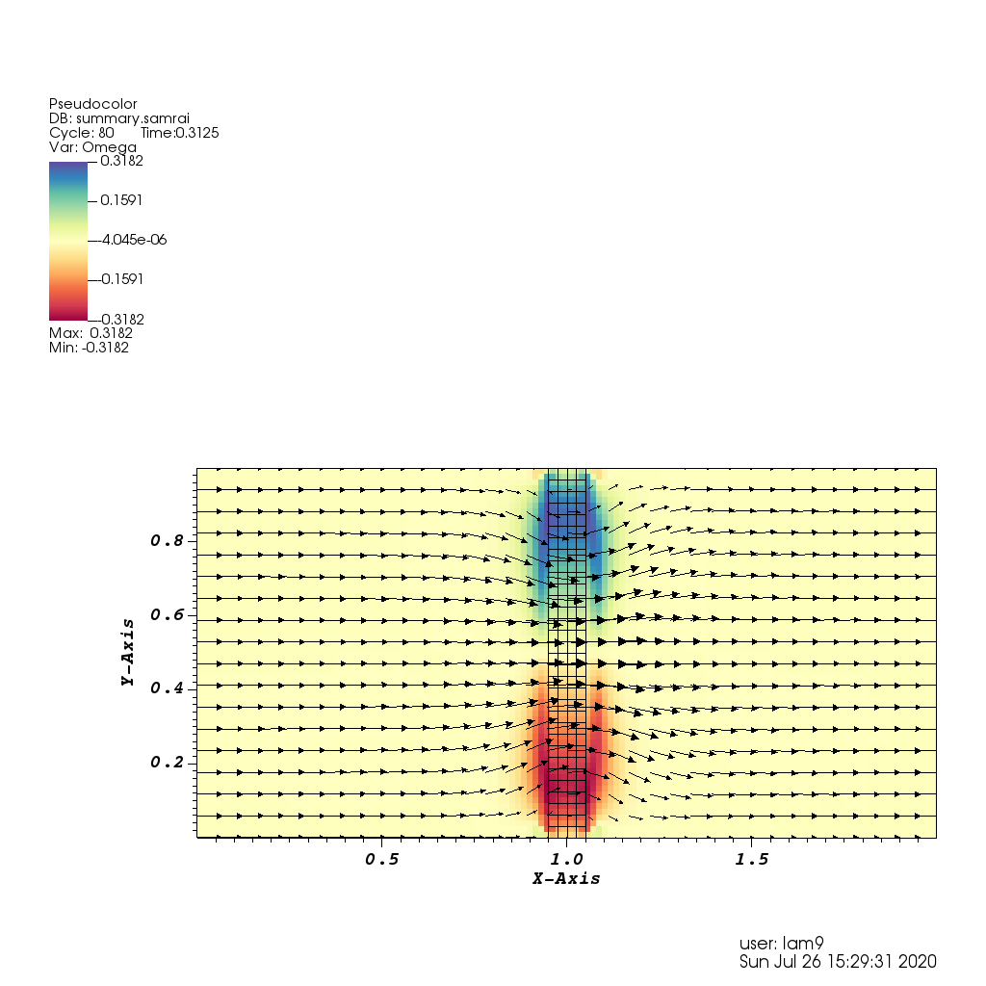
IBFE ex2
I believe that there are now porous FE boundaries in IBAMR, and this is the first example.
The porous plate takes up the entire channel, and flow is driven through it using the boundary conditions.
A 3D version is also available with input3d.

Slide 8
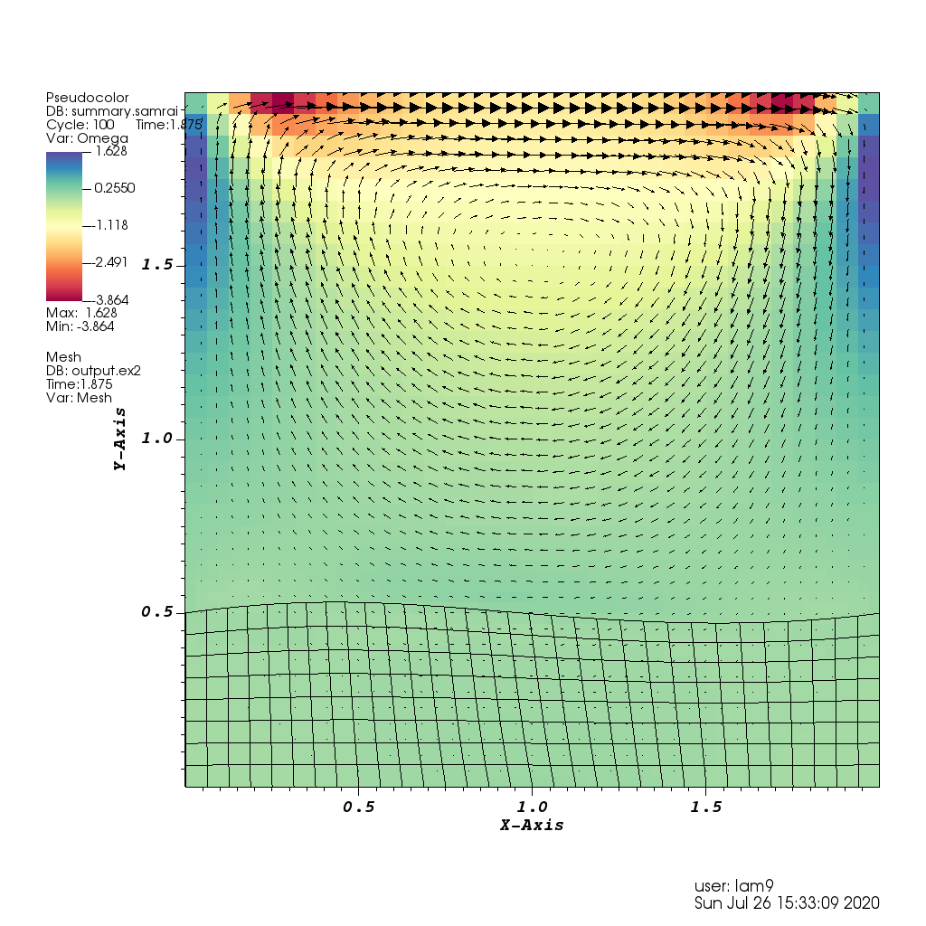
IBFE ex3
This is an example of cavity driven flow with a flexible material on the bottom.
The boundary conditions of the fluid domain are such that on the top, u = U, and on the sides and bottom, u = 0.
The colormap shows vorticity, and the arrows show the velocity.
There are convergence_tester files you want to remove or rename to run with our Makefile.

Slide 9
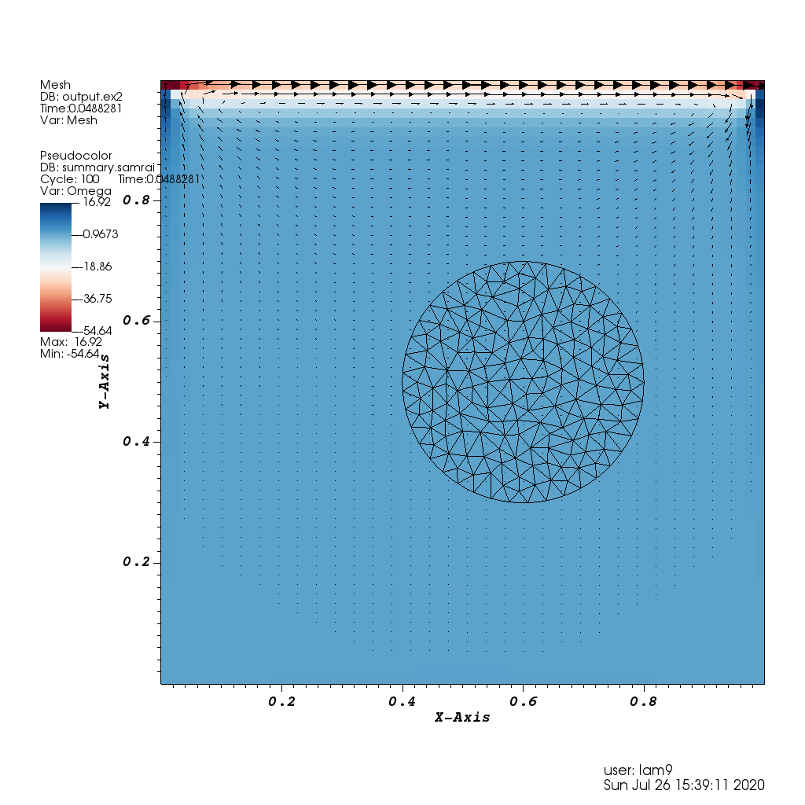
IBFE ex4
See Figure 10, Griffith and Luo.
“A soft neo-Hookean disc in a lid-driven cavity flow using the partitioned (split) weak formulation with N = 128 and Mfac = 4 over
the time interval 3 ⩽ t ⩽ 7”

Slide 10
IBFE ex4 cont’d
This example only runs for two data visualization writes. You can increase the endtime to run for longer.
There are convergence_tester files you want to remove or rename to run with our Makefile.
A 3D version is also available with input3d.

Slide 11
IBFE ex5
From Figure 12, Griffith and Luo
Vortices shed from a stationary circular cylinder at Re = 200.
I had some issues reading the .ex2 file for this. It looks like ex11 is a very similar example which does run well.
There is also a 3D case, use the input3d.
Lift and drag coefficients are written to .curve files.

Slide 12
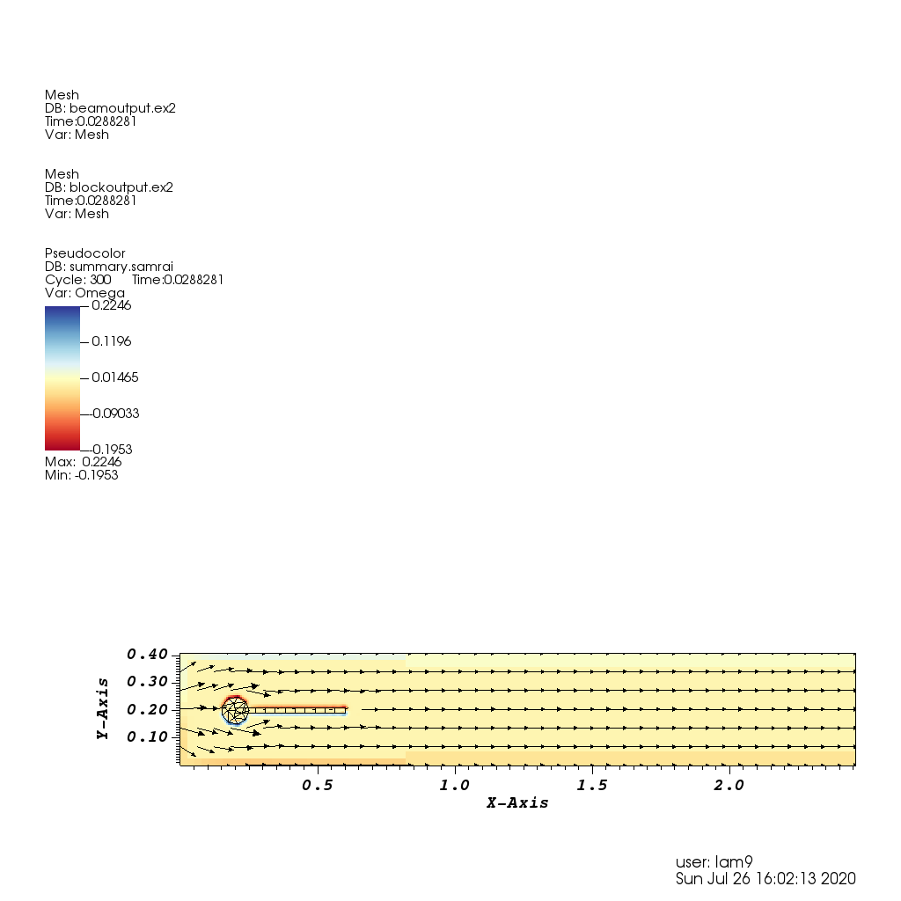
IBFE ex6
This example only runs for two data visualization writes. You can increase the endtime to run for longer.
This is a standard example of a relatively rigid circle attached to a flexible plate that bends as vortices or shed.
I believe it comes from a paper by Boyce, but I have not found it yet.

Slide 13
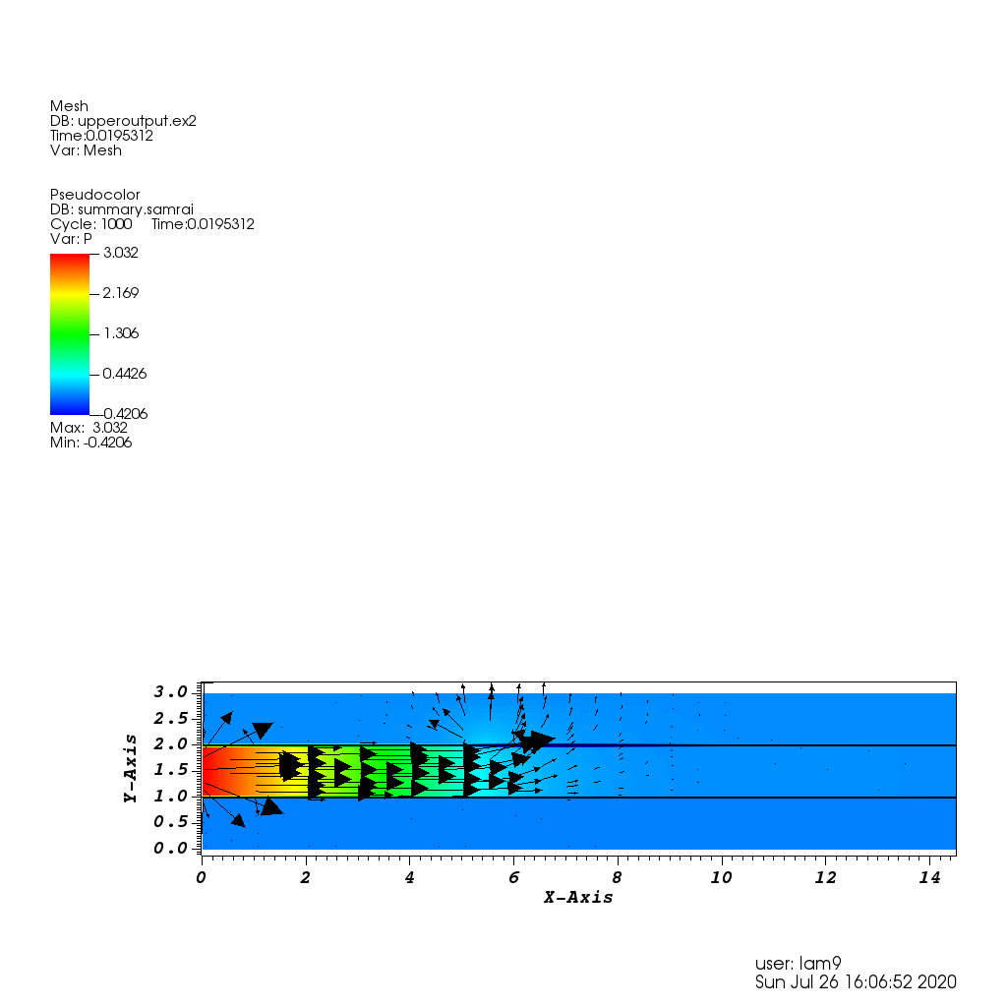
IBFE ex7
This example only runs for two data visualization writes. You can increase the endtime to run for longer.
I believe this is an example of peristaltic transport.
There are input files for caseC, caseS2, and caseSP. It would be worth running each for longer to see what they do.

Slide 14
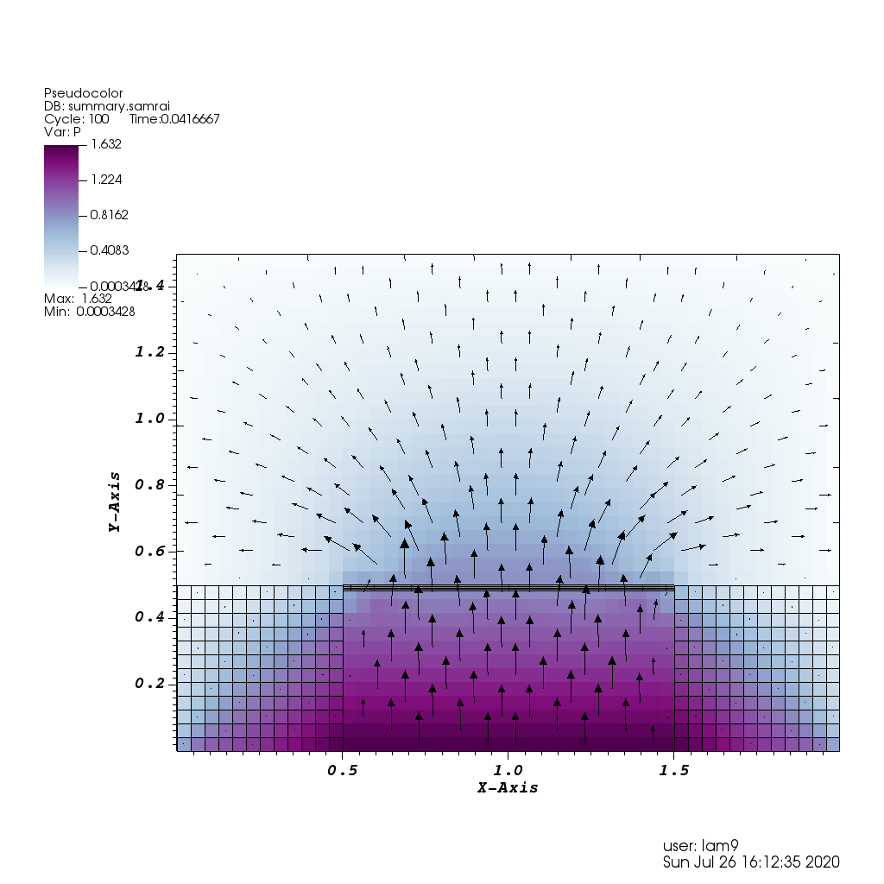
IBFE ex8
This is the second example of possible porous boundaries in IBAMR.
The example consists of two solid blocks with a rigid, porous plate on top.
Flow is driven from the bottom of the domain through the porous plate.

Slide 15
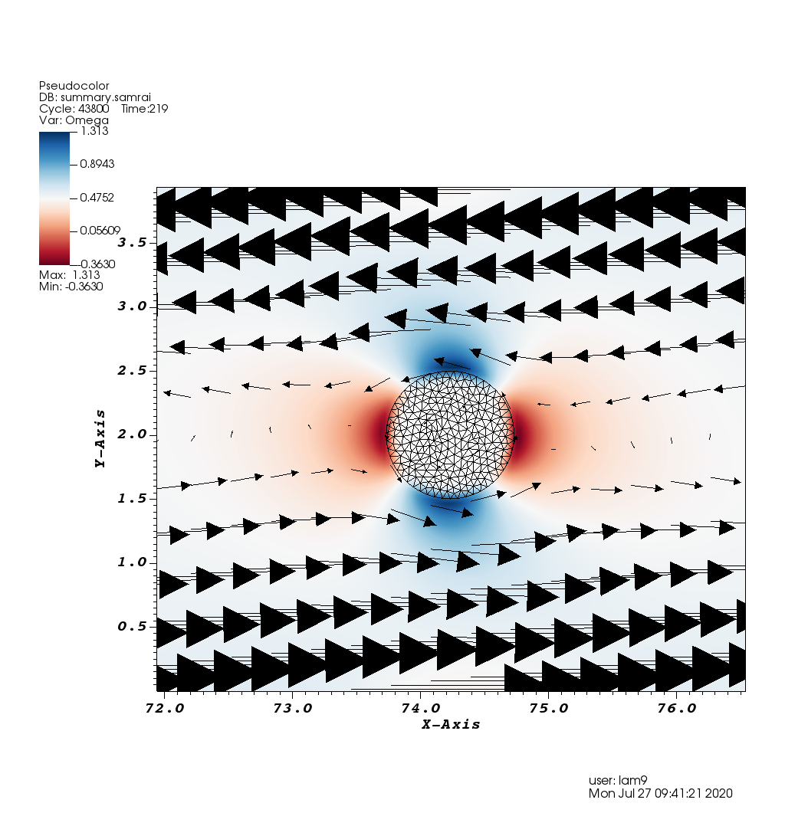
IBFE ex10
This is an example of an elastic circle freely moving in shear flow in 2D.
This is a long simulation with many file writes.
The position and velocity of the center of the ball are written to .curve files.

Slide 16
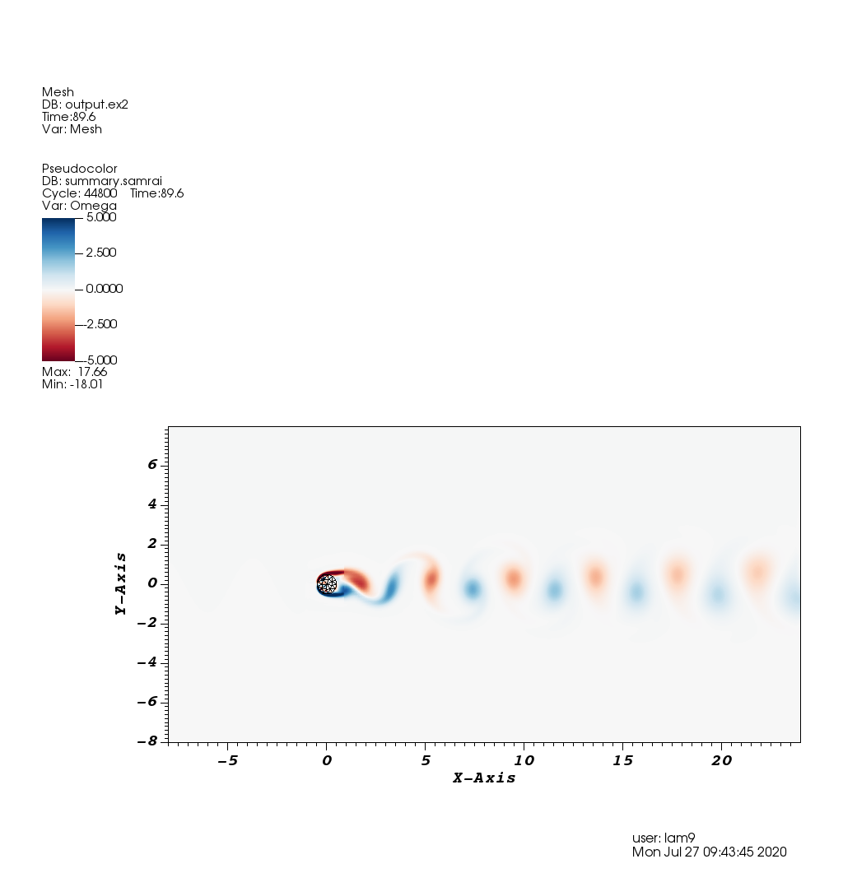
IBFE ex11
This is another example of flow past a cylinder.
It is a long simulation with many file writes.
The lift and drag coefficients are written to .curve files. There is a MATLAB file for calculating the Strouhal number.

Slide 17
Complex fluid examples
These examples come from Aaron Barrett’s dissertation (on the google drive).
They are all 2D examples of complex fluids modeled using Oldroyd-B (I think).
I could not get the examples with immersed boundaries to work (yet).

Slide 18
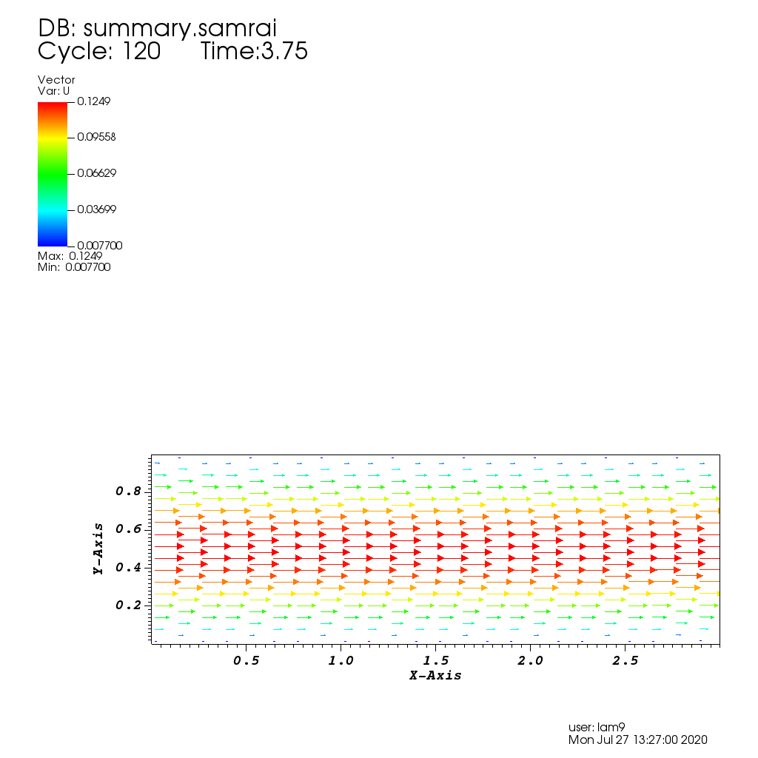
Complex_fluids ex0
This example sets up pipe flow.
There exists an exact solution for this problem.
Error norms are printed out for the components of the conformation tensor and for the velocity.

Slide 19
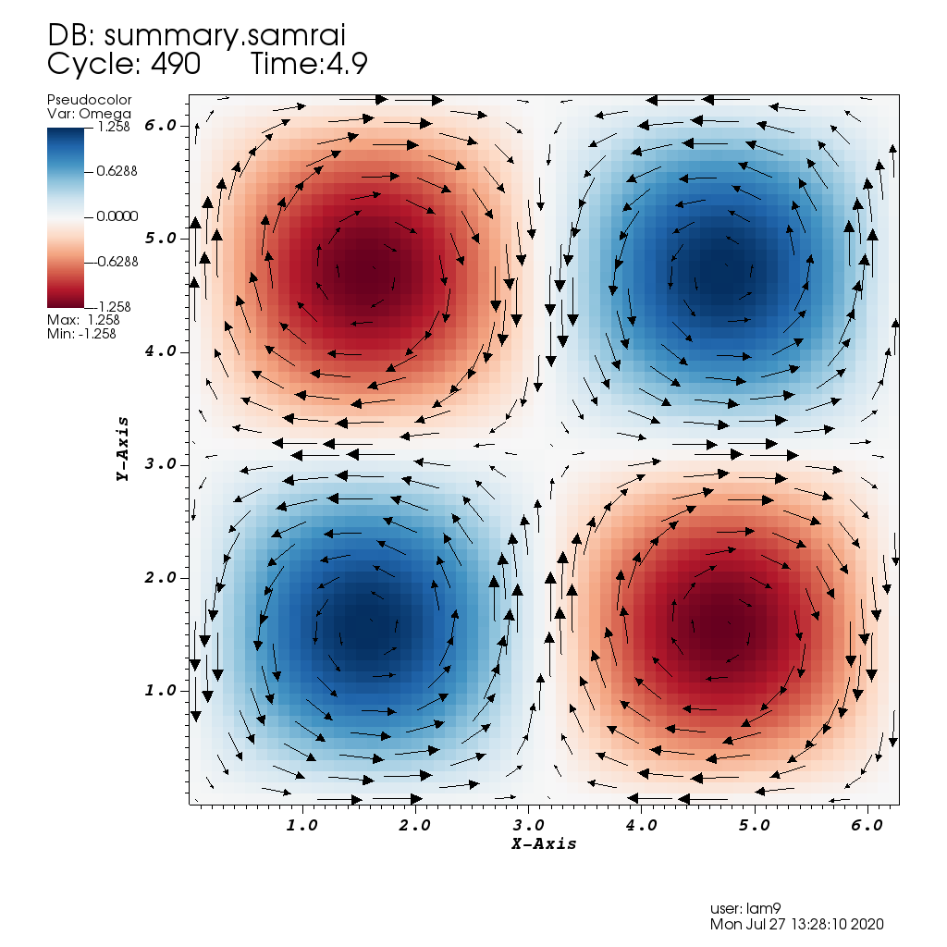
Complex_fluids ex1
This example sets up a four roll mill geometry where the rollers are modelled with a background periodic force.
As the Weissenberg number increases, singularities in the trace form at extensional points.

